Slide 1

Quiz Project
A robust interactive quiz application built with Java and Python | Developed by Technical Team | 2024

Slide 2

OVERVIEW
Empowering Learning Through Interactive Assessment
Quiz applications have transformed how we approach education and skill assessment. This project delivers an engaging platform that makes testing knowledge both effective and enjoyable.
Key Benefits
Immediate feedback for learners
Automated scoring and analytics
Our solution addresses the growing need for flexible, automated assessment tools that can be deployed across educational institutions, corporate training programmes, and self-learning platforms.
Scalable assessment delivery
Enhanced engagement through interactivity
By combining intuitive design with powerful functionality, we've created a system that benefits both quiz administrators and participants.

Slide 3





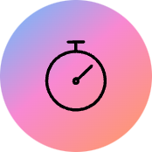



FEATURES
Comprehensive Quiz Functionality
Dynamic Question Management
Intelligent Scoring System
Support for multiple question types including multiple choice, true/false, and text responses with randomisation capabilities
Automated grading with customisable point allocation and instant results calculation
Built-in Timer Controls
Intuitive User Interface
Configurable time limits for entire quizzes or individual questions with countdown displays
Clean, responsive design ensuring seamless navigation and excellent user experience across devices

Slide 4
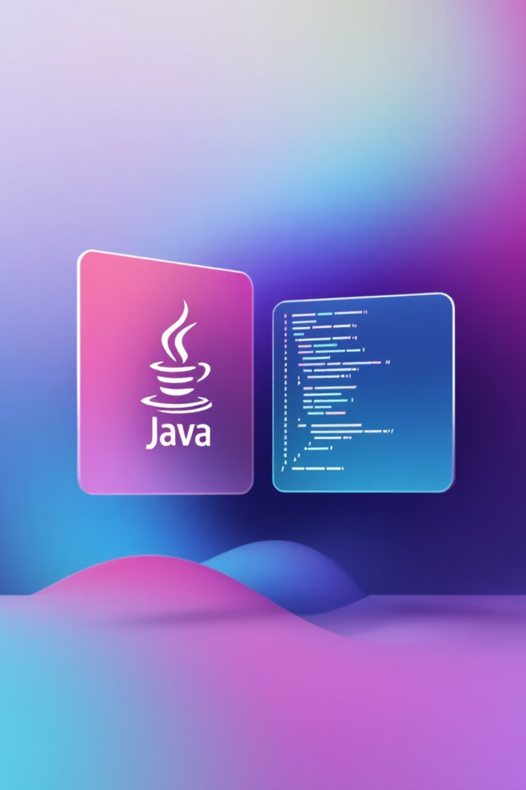

TECHNOLOGY
Robust Technology Stack
Java Implementation
Python Implementation
JavaFX for rich desktop UI
JDBC for database connectivity
Tkinter for GUI development
SQLite3 for data persistence
JUnit for comprehensive testing
Pytest for automated testing
Pandas for analytics processing
Maven for dependency management
Both implementations leverage object-oriented design principles, ensuring maintainable, scalable codebases with clear separation of concerns.

Slide 5



ARCHITECTURE
System Architecture Overview
Data Layer
Business Logic
Presentation Layer
Manages question banks, user data, and quiz results with persistent storage
Handles quiz flow, scoring algorithms, and validation rules
Renders UI components and manages user interactions
The architecture follows the Model-View-Controller pattern, promoting clean code organisation and facilitating future enhancements. Each layer communicates through well-defined interfaces, ensuring loose coupling and high cohesion throughout the application.

Slide 6


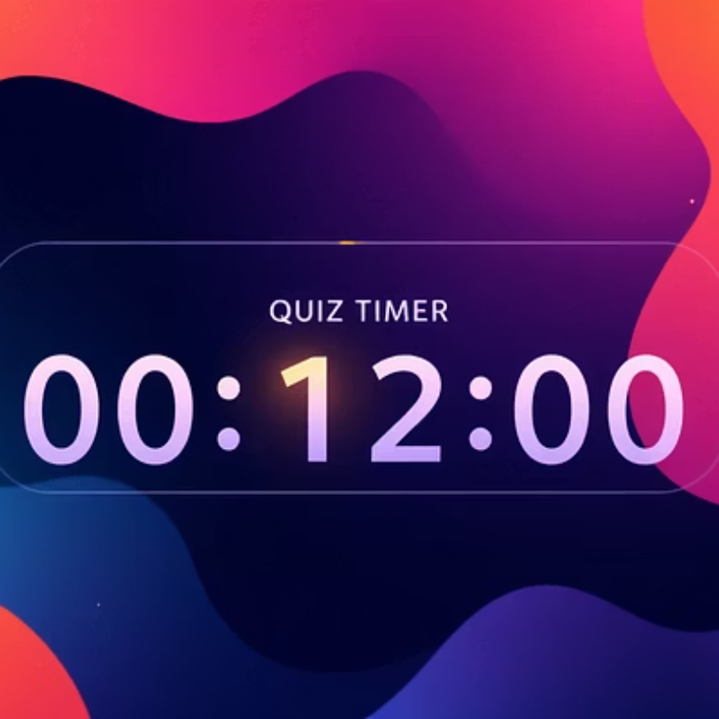
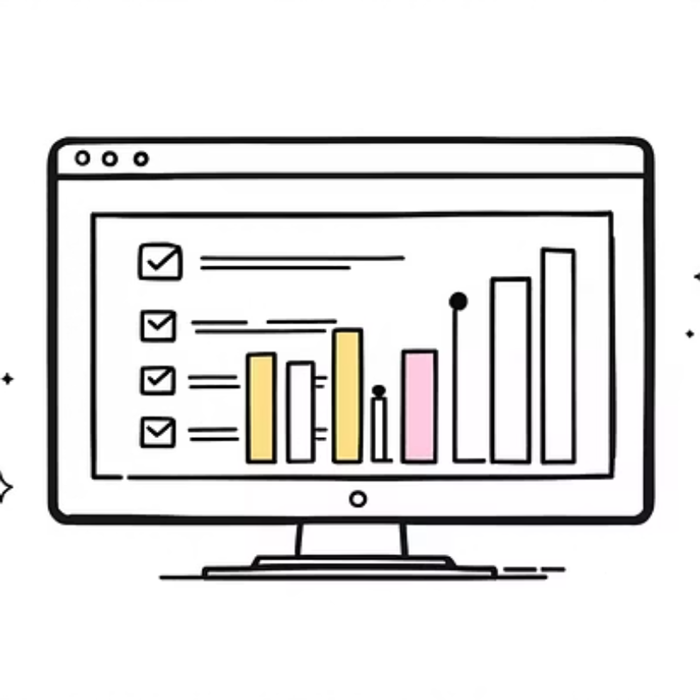
User Interface Showcase
Our interface design prioritises clarity and usability, featuring intuitive navigation, clear visual hierarchy, and responsive layouts that adapt seamlessly to different screen sizes.

Slide 7


CODE HIGHLIGHTS
Key Implementation Details
Question Randomisation (Java)
Score Calculation (Python)
Collections.shuffle(questionList); for (Question q : questionList) { displayQuestion(q); recordAnswer(q); }
def calculate_score(answers): correct = sum(1 for a in answers if a.is_correct) return (correct/len(answers))*100
Efficient scoring algorithm that handles various question types with percentage-based results.
Ensures fair assessment by presenting questions in random order whilst maintaining data integrity.
Design Pattern: Both implementations utilise the Strategy pattern for flexible question type handling, enabling easy addition of new question formats without modifying existing code.

Slide 8
CHALLENGES
Overcoming Technical Obstacles
Timer Synchronisation Challenge
Data Persistence Complexity
Cross-Platform Compatibility
Problem: Maintaining accurate timers across multiple threads whilst ensuring responsive UI updates.
Problem: Efficiently storing quiz sessions with varying question types and metadata.
Problem: Ensuring consistent behaviour and appearance across Windows, macOS, and Linux.
Solution: Designed flexible database schema using JSON fields for question-specific data whilst maintaining relational integrity for core entities.
Solution: Adopted platform-agnostic libraries and implemented comprehensive testing suites for each target platform.
Solution: Implemented dedicated timer threads with callback mechanisms and atomic operations for thread-safe state management.

Slide 9

FUTURE VISION
Roadmap for Enhancement
01
02
03
Global Leaderboards
Cloud-Based Deployment
Advanced Analytics Dashboard
Implement competitive elements with real-time rankings and achievement systems
Enable online quiz distribution with multi-user concurrent access and centralised management
Provide detailed performance insights with visualisations and progress tracking over time
04
05
AI-Powered Question Generation
Mobile Application Development
Leverage machine learning to automatically create relevant questions based on content topics
Extend reach with native iOS and Android apps for on-the-go quiz participation

Slide 10
Project Takeaways & Conclusion
Key Achievements
2
Successfully delivered a fully functional quiz application with comprehensive feature set
Languages
Demonstrated proficiency in both Java and Python ecosystems
Applied industry-standard design patterns and architectural principles
Java & Python
Created scalable, maintainable codebase ready for future enhancements
100%
Technical Insights
This project reinforced the importance of thoughtful architecture, rigorous testing, and user-centred design. The challenges encountered provided valuable learning opportunities in concurrent programming, data management, and cross-platform development.
Test Coverage
4
Key Features
"Building this quiz application demonstrated how thoughtful engineering transforms simple concepts into powerful educational tools."

